Slide 1



Noida Institute of Engineering and Technology, Greater Noida
IoT PROTOCOLS & ITS APPLICATIONS
Unit: 2
Application Layer
Mr. Amit Kumar
Asst. Professor
CSE-IoT Department
B Tech (CSE-IoT)
6th Sem

Slide 2
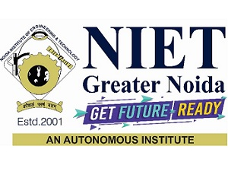


Brief Introduction of Faculty
Amit Kumar received his B.E degree in Electronics and Communication Engineering from Hindustan College of Science and Technology, Mathura, M.Tech degree in VLSI design from AKTU Lucknow. His major areas of research work include Wireless Communication. He has pursued his Ph.D in Wireless Communication from NIT Patna. He has more than 20 years of teaching experience.

Slide 3

Evaluation Scheme
1/5/2024
3
Notes:
3

Slide 4
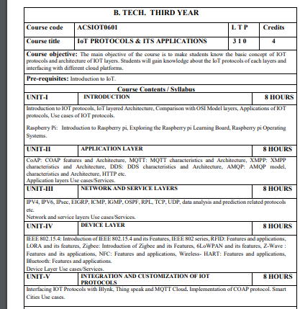
Subject Syllabus
1/5/2024
4
Notes:
4

Slide 5
Branch wise Applications
Electronics Engineering
Home Automation
Improving Security
Instructing Solar Panels
Microcontrollers
Civil Engineering:
Preventive Maintenance Programs
Real-Time Construction Management Solution
Automated documentation
Workers’ safety
Decision Making
Biomedical Engineering:
Wearable devices and IoT
Superlative Care
Faster Disease Diagnosis
Lesser stay in hospital

Slide 6
Course Objective
Student will learn about:
The architectural overview and IoT reference architecture.
Open source architecture and design principles.
The various types of IoT connectivity protocols.
Different types of IoT layered protocols.
Differences between Web of things and Internet of things.

Slide 7
Course Outcome
After completion of this course students will be able to:
CO 1 Identifying the essentials of IOT protocols. K1
CO 2 Articulate Application layer protocols. K3
CO 3 Tagging Network and service layer protocols. K2
CO 4 Understand the concepts of Device layer protocols. K2
CO 5 Build IoT-based smart systems for real-world problems using IOT K6

Slide 8
Program Outcomes
Program Outcomes are narrow statements that describe what the students are expected to know and would be able to do upon the graduation.
These relate to the skills, knowledge, and behavior that students acquire through the programmed.
Engineering knowledge
Problem analysis
Design/development of solutions
Conduct investigations of complex problems
Modern tool usage
The engineer and society
Environment and sustainability
Ethics
Individual and team work
Communication
Project management and finance
Life-long learning

Slide 9
CO-PO Mapping
 |  | IoT PROTOCOLS & ITS APPLICATIONS
CO | PO1 | PO2 | PO3 | PO4 | PO5 | PO6 | PO7 | PO8 | PO9 | PO 10 | PO 11 | PO 12
CO1 | 3 | 2 | 1 | 1 | 1 | 1 | 1 | - | 1 | 1 | 1 | 2
CO2 | 2 | 2 | 2 | 2 | 1 | 1 | - | 1 | 1 | 1 | 1 | 2
CO3 | 3 | 2 | 2 | 1 | 2 | 2 | 1 | 1 | 2 | 2 | 1 | 2
CO4 | 3 | 2 | 2 | 2 | 2 | 1 | 1 | - | 1 | 1 | 1 | 2
CO5 | 2 | 2 | 2 | 1 | 2 | - | 1 | - | 1 | 2 | 2 | 2
Average | 2.6 | 2 | 1.8 | 1.4 | 1.6 | 1 | 0.8 | 0.4 | 1.2 | 1.4 | 1.2 | 2

Slide 10

Program Specific Outcomes
S.NO. | PSO | PSO Description
1 | PSO1 | Apply concept of IoT to solve real world problems for societal wellbeing by leveraging latest tools.
2 | PSO2 | Work as an individual or lead as a team with good communication and engage in life-long learning.
3 | PSO3 | Apply ethical principles as a successful professional, entrepreneur, and pursue higher education.
1/5/2024
10
Notes:
10

Slide 11
Program Educational Objectives
Engage in designing, manufacturing/fabricating, and maintaining smart systems in the field of IoT.
Solve problems of social relevance through applying the knowledge of basic science, IoT and pursue higher education and research.
Engage in life-long learning, career enhancement, and be able to adapt to dynamic needs of profession and society.
Work as an individual and as a team member in multidisciplinary projects with effective communication.
11
Notes:
11

Slide 12
Prerequisite and Recap
Basics of Internet of Things
Concept of Networking
IoT connectivity protocols

Slide 13
Brief Introduction about Subject
The Internet of Things is an emerging subject of technical, social, and economic significance, which has its application enormously increased in the past few years, it has a vast scope of usage.
IoT generally refers to a growing network of internet-connected devices that find various applications in engineering and sciences. When objects are interconnected across the world it allows people or things using those objects to be connected anytime. Connected things shall ease human life. As an example from urban transport to medical devices, home electronics and appliances to cars, heart monitoring implants and many more.
Video Link: Video Link:
https://www.youtube.com/watch?v=O--rkQNKqls&list=PLEAYkSg4uSQ2NMmzNNsEK5RVbhxqx0BZF

Slide 14
Unit Content
CoAP: COAP features and Architecture,
MQTT: MQTT characteristics and Architecture,
XMPP: XMPP characteristics and Architecture,
DDS: DDS characteristics and Architecture,
AMQP: AMQP model,
characteristics and Architecture, HTTP etc.
Application layers Use cases/Services.

Slide 15
Unit Objective
Student will learn about different types of Application Layer protocols.

Slide 16
Introduction to Topic 1
Name of Topic | Objective of Topic | Mapping with CO
APPLICATION LAYER | Students will be able to learn about Application Layer protocol standardization for IoT and its efforts. | CO4

Slide 17
Protocol Standardization for IoT
The IoT- A (Internet of Things architecture) is targeting a universal architecture for all IoT sectors.
17 European organizations from nine countries are a part of IoT- A.
They summarize the current status of IoT standardization as :
Fragmented architectures
No universal approach to implement IoT has yet been proposed
island solutions do exist (RFID, sensor nets, etc.)
Little cross-sector reuse of technology and exchange of knowledge
Proposed Solution By IoT-A for Standardization:
Create Architectural foundation for IoT, that will be operable with future Internet
Use Existing technologies instead of creating new ones.
Demonstrating the applicability of IoT in a set of use cases
Establish a strong stakeholder group to remove the barriers and accept IoT on wide scale
Combine various IoT technologies into a single entity

Slide 18
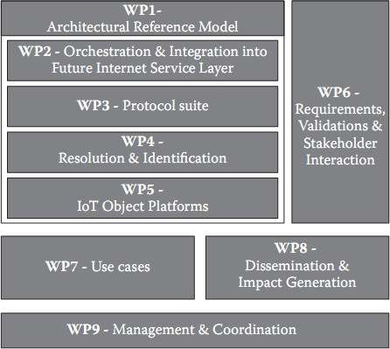
Protocol Standardization for IoT
Groups doing IoT Standardization:
1. Work Package Framework
The WPF divides the implementation standards of IoT into hierarchical groups of tasks as shown in the below

Slide 19
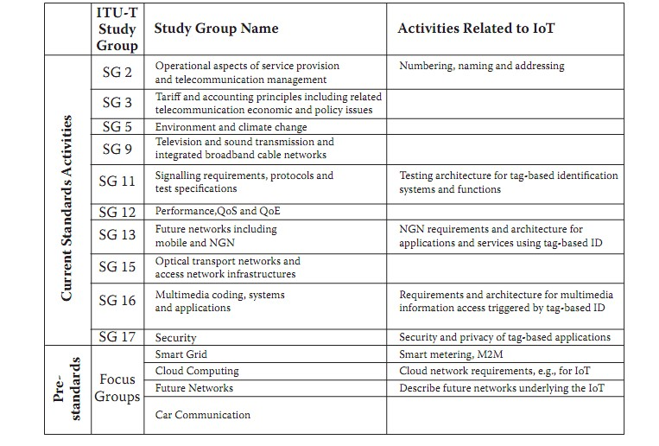
Protocol Standardization for IoT
2. ITU-T:
The ITU-T mission is to ensure the efficient and timely production of standards covering all fields of telecommunications on a worldwide basis, as well as defining tariff and accounting principles for international telecommunication services.
The technical work, the development of Recommendations, of ITU-T is managed by Study Groups (SGs). There are currently 11 SGs.

Slide 20
Protocol Standardization for IoT
3. Internet Protocol for Smart Objects (IPSO)
The IPSO Alliance is an open, informal and thought-leading association of like-minded organizations and individuals that promote the value of using the Internet Protocol for the networking of Smart Objects.
IP Stack can easily run on tiny, battery operated embedded devices as it is long-lived and stable technology.
The role of the alliance is to ensure how IPv4, IPv6, and 6LoWPAN are used, deployed and provided to all potential users.
Mobile IP is an approach by IETF (Internet Engineering Task Force) which manages the movement of mobile devices over IPV4 and IPV6

Slide 21
M2M Standardization Efforts
M2M Standardization Task Force (MSTF) coordinate the efforts of individual standards development organizations (SDO)for M2M Applications.
These define a conceptual framework for M2M applications and specify a service layer that will enable application developers to create applications that operate transparently across different vertical domains.
M2M standards activities include the following:
Use JSON as Data Transport Format
Resolve IP addressing issues for devices IPV6
Use Open REST- based API for M2M applications
Remote management of devices behind a gateway or firewall be done

Slide 22
WSN Standardization Efforts
There are number of standardization bodies in the field of WSNs
The IEEE focuses on the physical and MAC layers
IETF works on layers 3 and above.
IEEE 1451 is a set of smart transducer interface standards developed by the IEEE Instrumentation and Measurement Society’s Sensor Technology Technical Committee that describe a set of open, common, network- independent communication interfaces for connecting sensors or actuators) to microprocessors, instrumentation systems, and control/field networks.
The goal of the IEEE 1451 family of standards is to allow the access of transducer data through a common set of interfaces whether the transducers are connected to systems or networks via a wired or wireless means.

Slide 23
WSN Standardization Efforts
1451.0-2007 Common Functions, Communication Protocols
1451.1-1999 Network Capable Application Processor Information Model
1451.2-1997 Transducer to Microprocessor Communication Protocols
1451.3-2003 Digital Communication Formats for Distributed Multi- drop Systems
1451.4-2004 Mixed- mode Communication Protocols
1451.5-2007 Wireless Communication Protocols
1451.7-2010 Transducers to Radio Frequency Identification (RFID) Systems Communication Protocols

Slide 24
SCADA Standardization Efforts
IEEE created a standard specification, called Std C37.1™, for SCADA and automation systems.
The processing is now distributed, and functions that used to be done at the control center can now be done by the intelligent electronic devices (IED) that is, M2M between devices.
The ISA100 was developed by the standards committee of the Industrial Society for Automation formed to define procedures for implementing wireless systems in the automation and control environment with a focus on the field level.
OPC, which stands for Object Linking and Embedding (OLE) for Process Control standard specification developed by an industrial automation industry task force (IAITF)

Slide 25
SCADA Standardization Efforts
The standard specifies the communication of real- time plant data between control devices from different manufacturers.
OPC was designed to provide a common bridge for Windows- based software applications and process control hardware.

Slide 26
RFID Standardization Efforts
The RFID protocols and data formats are relatively well defined, mostly by EPCglobal (Electronic Product Code).
The standard for contactless smart card communications is ISO/ IEC 14443 allows for communications at distances up to 10 cm.
ISO/ IEC 15693, which allows communications at distances up to 50 cm International Organization for Standardization (ISO) and the International Electrotechnical Commission (IEC)

Slide 27
Daily Quiz
Protocol is a set of
Formats
Procedures
Formats & Procedures
None of the mentioned
2. What is Proposed Solution By IoT-A for Standardization IOT?
To create an architecture of foundation for iot.
Use existing Technologies instead of a new one.
Establish a strong stakeholder group.
All of the above

Slide 28
Daily Quiz
3. Which one of the following groups are doing IoT Standardization?
Work Package Framework (WPF)
IEEE
IAITF
All of the above
4. Mobile IP is an approach by___.
IEEE
MSTF
IETF
ITU-T

Slide 29
Recap
The IoT- A (Internet of Things architecture) is targeting a universal architecture for all IoT sectors.
M2M Standardization Task Force (MSTF) coordinate the efforts of individual standards development organizations (SDO)for M2M Applications.
The RFID protocols and data formats are relatively well defined, mostly by EPCglobal (Electronic Product Code).
Issues: Standardization is like a double- edged sword: critical to market development, but it may threaten innovation and inhibit change when standards are accepted by the market.

Slide 30
Introduction to Topic 2
Name of Topic | Objective of Topic | Mapping with CO
M2M and WSN Protocols | Students will be able to learn about M2M and WSN Protocols. | CO4

Slide 31
IoT Protocols: MQTT
MQTT (Message Queue Telemetry Transport) is a messaging protocol developed with the aid of Andy Stanford-Clark of IBM and Arlen Nipper of Arcom in 1999 and is designed for M2M communication. It’s normally used for faraway tracking in IoT.
Its primary challenge is to gather statistics from many gadgets and delivery of its infrastructure. MQTT connects gadgets and networks with packages and middleware.
All the devices hook up with facts concentrator servers like IBM’s new message sight appliance. MQTT protocols paintings on top of TCP to offer easy and dependable streams of information.
These IoT protocols include 3 foremost additives: subscriber, publisher, and dealer. The writer generates the information and transmits the facts to subscribers through the dealer. The dealer guarantees safety by means of move-checking the authorization of publishers and subscribers.

Slide 32
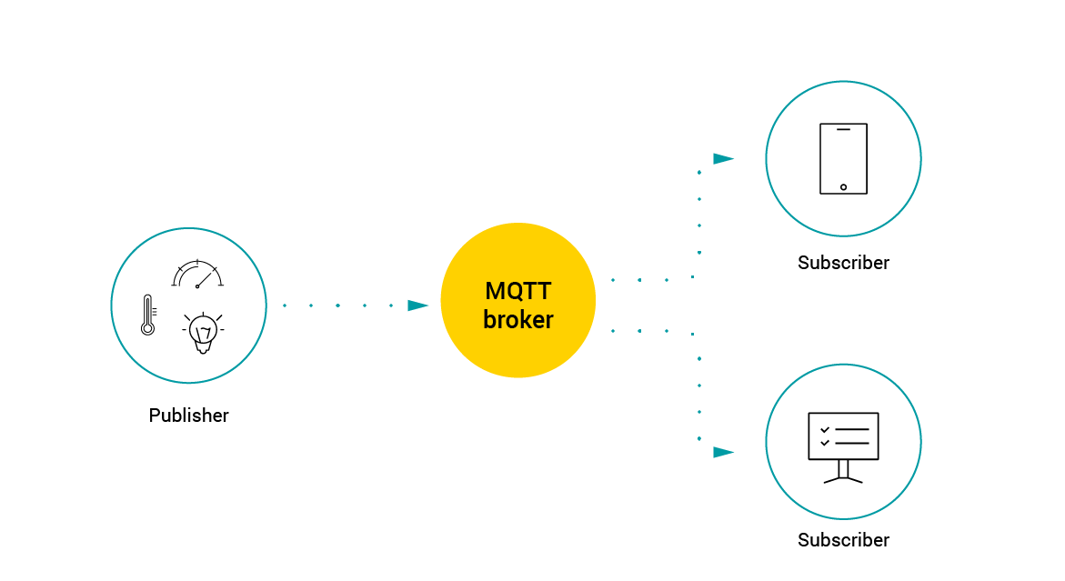
IoT Protocols: MQTT

Slide 33
IoT Protocols: CoAP
CoAP stands for Constrained Application Protocol
CoAP is an internet utility protocol for constrained gadgets.
It is designed to enable simple, constrained devices to join IoT through constrained networks having low bandwidth availability.
This protocol is primarily used for machine-to-machine (M2M) communication and is particularly designed for IoT systems that are based on HTTP protocols.
CoAP makes use of the UDP protocol for lightweight implementation. It also uses restful architecture, which is just like the HTTP protocol.

Slide 34
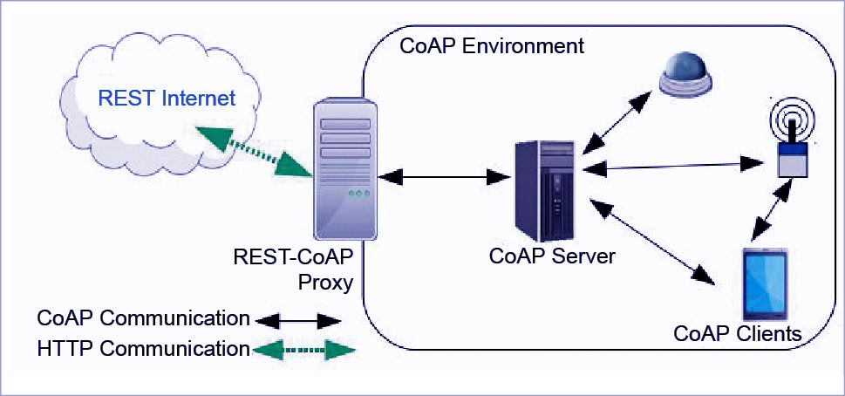
IoT Protocols: CoAP

Slide 35
IoT Protocols: XMPP
XMPP stands for Extensible Messaging and Presence Protocol
Developed in 1999 by the Jabber open source community and originally meant for real-time messaging, this communication IoT protocol for message-oriented middleware is based on the XML language.
It allows for real-time exchange of structured but extensible data between two or more network clients.
Being an open community supported standard, XMPP IoT’s strengths are addressing and scalability capabilities, which makes it perfect for consumer-oriented IoT deployments.
Among the drawbacks of using XMPP in IoT communication, it should be noted that it offers neither Quality of Service nor end-to-end encryption.

Slide 36
IoT Protocols: AMQP
AMQP stands for Advanced Message Queuing Protocol
This was evolved by John O’Hara at JP Morgan Chase in London.
AMQP is a software layer protocol for message-oriented middleware environment.
It supports reliable verbal exchange through message transport warranty primitives like at-most-once, at least once and exactly as soon as shipping.
The AMQP – IoT protocols consist of hard and fast components that route and save messages within a broker carrier, with a set of policies for wiring the components together.
The AMQP protocol enables patron programs to talk to the dealer and engage with the AMQP model.

Slide 37
IoT Protocols: AMQP
This version has the following three additives, which might link into processing chains in the server to create the favoured capabilities:
Exchange: Receives messages from publisher primarily based programs and routes them to ‘message queues’.
Message Queue: Stores messages until they may thoroughly process via the eating client software.
Binding: States the connection between the message queue and the change.

Slide 38
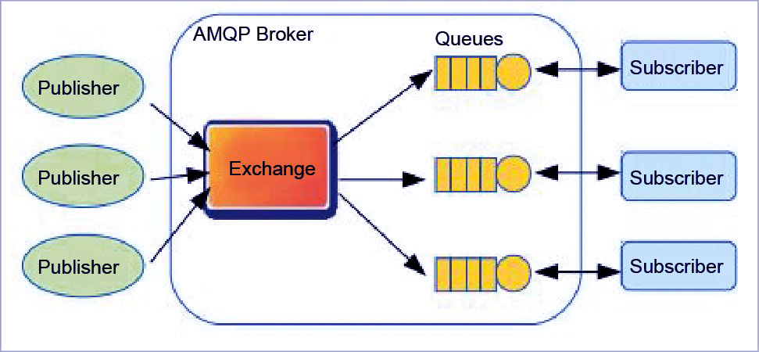
IoT Protocols: AMQP

Slide 39
Daily Quiz
What is a protocol?
Name any two IoT Protocols.
AMQP stands for____________.
Adjustable Message Queuing Protocol
Advanced Message Queuing Protocol
Application Message Queuing Protocol
Application Mailing Queue Protocol
4. _________ are the components of MQTT Protocol.
Subscriber
Broker
Publishers
All of the above

Slide 40
Daily Quiz
4. What is the standard form of SMQTT?
______ are the MQTT methods.
Connect, Disconnect
Subscribe, Unsubscribe
Publish
All of the above

Slide 41
Recap
IoT protocols are a crucial part of IoT technology. Without them, hardware would be rendered useless as IoT protocols enable it to exchange data in structured and meaningful way.
CoAP stands for Constrained Application Protocol. It is an internet utility protocol for constrained gadgets.
XMPP stands for Extensible Messaging and Presence Protocol. It allows for real-time exchange of structured but extensible data between two or more network clients.
AMQP is a software layer protocol for message-oriented middleware environment

Slide 42
Introduction to Topic 3
Name of Topic | Objective of Topic | Mapping with CO
SCADA and RFID Protocols | Students will be able to learn about the various SCADA and RFID Protocols. | CO4
Notes:
https://iotnotesbyparita.wordpress.com/iot-reference-architecture/

Slide 43
SCADA Protocols
DNP3 Protocol
DNP3 stands for distributed network protocol and it consist of a set of communication protocols used between components which are used in process automation systems like electric utility, chemical process plants, etc.
The purpose of DNP3 is to accomplish communication between various types of monitoring, data acquisition systems and control equipment.
This protocol forms an integral part in SCADA systems while interconnecting the RTUs and IEDs named as the Inter –Control Center Communications (ICCP) protocol.
ICCP is a part of IEC 60870 and is widely used in inter- master station communications.
DNP3 protocols were not designed to be secure from hackers and threats. There was a need to introduce security authentication to the DNP3 protocol.
Notes:
https://instrumentationtools.com/scada-communication-and-protocols/#

Slide 44
SCADA Protocols
Features of DNP3 Protocol:
DNP3 protocol is characterized by important features that makes it inter-operable with related protocols like MODBUS, etc. This makes it more efficient and efficient for communicating between components in SCADA systems.
DNP3, with reference to the widely used OSI model for communicating networks, corresponds to layer 2, which provides multiplexing of various features like error checking, link control, data fragmentation, etc.
DNP3 provides a transport function (layer 4) and Application layer (Layer 7) corresponding to SCADA applications.
DNP3 has improved bandwidth efficiency which is accomplished through event oriented data reporting.
DNP3 has good ability to handle error detection.
Notes:
https://instrumentationtools.com/scada-communication-and-protocols/#

Slide 45
SCADA Protocols
2. IEC60870 Protocol:
IEC standard 60870 is widely used for controlling electric power transmission grids and other process plants.
This standard can be used for interoperating various equipment from different suppliers through standardized protocols.
IEC standard 60870 has six parts, defining general information related to the standard, operating conditions, electrical interfaces, performance requirements, and data transmission protocols.
IEC 60870 provides a communication profile for tele-control messages between two directly connected systems.
This protocols provides tele-control and tele-protection of electric power systems through associated tele-communication.
Notes:
https://instrumentationtools.com/scada-communication-and-protocols/#

Slide 46
SCADA Protocols
IEC 60870-5 has five parts:
IEC 60870-5-1: Transmission Frame Formats
IEC 60870-5-2: Data Link Transmission Services
IEC 60870-5-3; General Structure of Application Data
IEC 60870-5-4; Definition and Coding of Information Elements
IEC 60870-5-5; Basic Application Functions
Notes:
https://instrumentationtools.com/scada-communication-and-protocols/#

Slide 47
SCADA Protocols
3. HDLC:
HDLC (High Level Data Link Control) is a bit oriented code transparent synchronous data link layer protocol developed by ISO.
HDLC provides connection – oriented and connection – less service.
Though HDLC can be used for point to point multi point connections, but is preferable to use one to one connections, known as asynchronous balanced mode (ABM).
It forms the basis for all modern protocols.
Notes:
https://instrumentationtools.com/scada-communication-and-protocols/#

Slide 48
SCADA Protocols
4. MODBUS:
MODBUS is a serial communications protocol originally published by MODICON in 1979 for use with its programmable logic controllers.
MODBUS protocol is simple and robust which has become a widely used standard communication protocol for connecting industrial electronic devices.
The advantages of MODBUS protocol from an industry point of view are
1. Industry centric.
2. Open Source
3. Easy to use and deploy
Notes:
https://instrumentationtools.com/scada-communication-and-protocols/#

Slide 49
RFID Protocols
The protocols are called the air-interface protocols, and there are many “standards” for such protocols, depending on the type of RFID system used. Here are a few of the most common air-interface protocol standards ratified by the International Organization for Standardization (ISO):
ISO 14443: This high-frequency (HF) standard is designed to have a short read range and include encryption, since it was created for proximity cards. What that means is that it was created for secure payments.
ISO 15693: This HF standard was developed for vicinity cards. It has no encryption and a longer read range than ISO 14443-based systems. It is used in many access-control systems, but has also been employed for inventory management and other applications.
ISO 18000-3: This HF standard, developed for item management, has never really caught on. Most companies simply use ISO 15693 for item management.
Notes:
https://instrumentationtools.com/scada-communication-and-protocols/#

Slide 50
RFID Protocols
Near Field Communication: While not an official ISO standard, NFC is based on ISO 14443 and adds some additional capabilities, such as the ability of a reader to emulate a tag. NFC will also incorporate ISO 15693 over time, so you will be able to use an NFC-enabled phone to enter a building.
ISO 18000-6C: This ultrahigh-frequency (UHF) standard is based on the EPC Gen 3 air-interface protocol. Although there is an ISO 1800-6A and an ISO 1800-6B, it is ISO 18000-6C that is widely used for passive UHF systems.
ISO 24730: This protocol governs the communication of active RFID transponders operating at 2.45 GHz, and is used in real-time location systems.
Notes:
https://instrumentationtools.com/scada-communication-and-protocols/#

Slide 51
Daily Quiz
What is the full form of SCADA?
Supervisory Control and Document Acquisition
Supervisory Control and Data Acquisition
Supervisory Column and Data Assessment
Supervisory Column and Data Assessment
2. What is SCADA?
Software
Process
System
Hardware

Slide 52
Daily Quiz
3. The control in SCADA is ______. a) Online control b) Direct control c) Supervisory control d) Automatic control
4. What is the use of the RFID Module? a) Object Identification b) To provide 3G Connectivity c) To measure temperature d) To measure Wi-Fi strength

Slide 53
Recap
DNP3 protocol is characterized by important features that makes it inter-operable with related protocols like MODBUS, etc. This makes it more efficient and efficient for communicating between components in SCADA systems.
IEC standard 60870 is widely used for controlling electric power transmission grids and other process plants.
MODBUS protocol is simple and robust which has become a widely used standard communication protocol for connecting industrial electronic devices.
RFID protocols are called the air-interface protocols, and there are many “standards” for such protocols, depending on the type of RFID system used.

Slide 54
Introduction to Topic 4
Name of Topic | Objective of Topic | Mapping with CO
Issues with IoT Standardization and Unified Data Standards | Students will be able to learn about the issues with IoT Standardization and Unified Data Standards. | CO4

Slide 55
IoT Standardization Issues
Standardization is like a double- edged sword: critical to market development, but it may threaten innovation and inhibit change when standards are accepted by the market.
Different consortia, forums, and alliances have been doing standardization in their own limited scope
For example, 3GPP covers only cellular wireless networks while EPC global’s middleware covers only RFID events.
Even within the same segment, there are more than one consortium or forum doing standardization without enough communication with each other
Some are even competing with each other.

Slide 56
IoT Standardization Issues
Some people believe that the IoT concept is well established. However, some gray zones remain in the definition, especially which technology should be included
Following two issues for IoT standardization in particular and ICT standardization in general may never have answers:
ICT standardization is a highly decentralized activity. How can the individual activities of the network of extremely heterogeneous standards setting bodies be coordinated?
It will become essential to allow all interested stakeholders to participate in the standardization process toward the IoT and to voice their respective requirements and concerns. How can this be achieved?

Slide 57
Unified Data Standards
HTML/HTTP combination data format and exchange protocol is the foundation pillar of the World Wide Web.
Many standardization efforts have been trying to define a unified data representation and protocol for IoT.
Before the IoT, the Internet was actually an Internet of documents or of multimedia documents. The two pillars of the Internet including HTML/HTTP turned the Internet into the WWW.
By the same token, we need to turn the IoT into the WoT to make sense of everything.

Slide 58
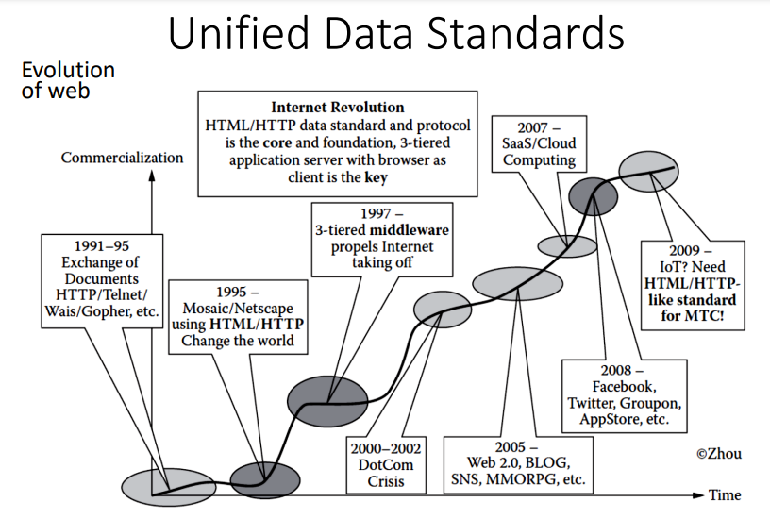
Unified Data Standards

Slide 59
Unified Data Standards
What will it take to make this to happen?
– Do we need a new HTML/HTTP-like standard for WoT? If there is no need to reinvent the wheel, what extensions do we need to build on top of HTML/HTTP or HTML5?
– The browser is intended for humans, so do we need a new browser for machines to make sense of the ocean of machine-generated data?
– Today, most new protocols are built on top of XML. For OS there must be XML-based data format standards or a metadata standard to represent the machine-generated data (MGD). Is it possible to define such a metadata standard that covers everything?

Slide 60
Unified Data Standards
Mango is an open-source software system for M2M application. It enables users to access and control electronic sensors, devices, and machines over multiple protocols simultaneously.
The Resource Description Framework (RDF) is a family of W3C specifications originally designed as a metadata model.
SOAP and RESTful protocol frameworks are extension on top of HTTP for web services and they are used to provide data exchange protocols for IoT applications.
There are two important enabling technologies electronic data interchange (EDI) and XML
EDI describes the rigorously standardized format of electronic documents.

Slide 61
Unified Data Standards
XML is a more recent invention for exchanging information between computer systems. XML is a markup language used to create smart data and documents for applications.
ebXML incooporates as part of its design solution some borrowed ideas from both EDI and XML. It offers businesses the opportunity to build an interoperable e-commerce infrastructure.
ebXML (e-business XML) specifies the business rules for how two different system talk to each other.

Slide 62
Daily Quiz
Object oriented analysis and design can be handled by the one who knows UML.
True
False
2. ebXML is the combination of___
EDL & XML
EDI & XML
HTML & XML
None of the above

Slide 63
Daily Quiz
3. EPCglobal works only for RFID.
a. True
b. False
4. Physical markup language (PML) is based____.
EDL
EDI
HTML
XML

Slide 64
Recap
Standardization is like a double- edged sword: critical to market development, but it may threaten innovation and inhibit change when standards are accepted by the market.
Mango is an open-source software system for M2M application. It enables users to access and control electronic sensors, devices, and machines over multiple protocols simultaneously.
The Resource Description Framework (RDF) is a family of W3C specifications originally designed as a metadata model.
SOAP and RESTful protocol are used to provide data exchange protocols for IoT applications.

Slide 65
Introduction to Topic 5
Name of Topic | Objective of Topic | Mapping with CO
Protocols: IEEE802.15.4, IEEE 802.11, BAC Net, Modbus and KNX | Students will be able to learn about various protocols like BAC Net, Modbus, IEEE802.15.4, IEEE 802.11, and KNX. | CO4

Slide 66
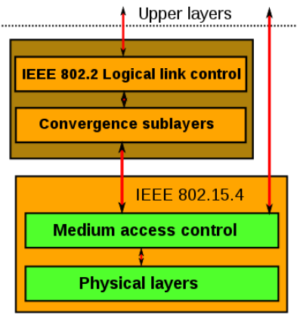
IEEE802.15.4
Defines operation of low-rate wireless personal area networks (LR-WPANs).
Specifies physical layer and media access control for LR-WPANs • Maintained by IEEE 802.15 working group, which defined the standard in 2003.
Basic framework conceives a 10m communications range with a transfer rate of 250 kbit/s.
Physical Layer (PHY) provides data transmission service & interface to physical layer management entity.
MAC enables transmission of MAC frames through the use of the physical channel
Notes:
https://www.geeksforgeeks.org/introduction-of-ieee-802-15-4-technology/

Slide 67
IEEE802.15.4
Advantages of IEEE 802.15.4
cheap cost
long battery life,
Quick installation
simple
extensible protocol stack
Disadvantages of IEEE 802.15.4:
IEEE 802.15.4 causes interference and multipath fading.
doesn’t employ a frequency-hopping approach.
unbounded latency
interference susceptibility
Notes:
https://pdfs.semanticscholar.org/5f2a/4982a8adef2d1a6d589a155143291d440c0a.pdf

Slide 68
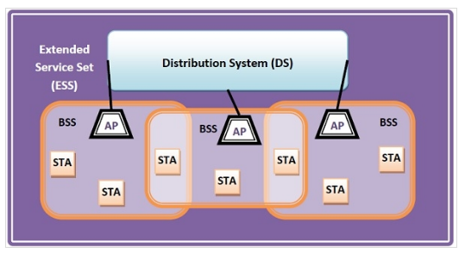
IEEE802.11
IEEE 802.11 standard, popularly known as WiFi, lays down the architecture and specifications of wireless LANs (WLANs).
WiFi or WLAN uses high-frequency radio waves instead of cables for connecting the devices in LAN.
Users connected by WLANs can move around within the area of network coverage.
IEEE 802.11 Architecture
Notes:
https://www.tutorialspoint.com/what-are-ieee-802-11-networks

Slide 69
IEEE802.11
Components of IEEE 802.11 Architecture
Stations (STA): Stations comprises of all devices and equipment that are connected to the wireless LAN. A station can be of two types:
Wireless Access Point (WAP)
Simply access points (AP)
Each station has a wireless network interface controller.
Basic Service Set (BSS): A basic service set is a group of stations communicating at the physical layer level. BSS can be of two categories:
Infrastructure BSS − Here, the devices communicate with other devices through access points.
Independent BSS − Here, the devices communicate in a peer-to-peer basis in an ad hoc manner.
Extended Service Set (ESS): It is a set of all connected BSS.
Distribution System (DS): It connects access points in ESS
Notes:
https://pdfs.semanticscholar.org/5f2a/4982a8adef2d1a6d589a155143291d440c0a.pdf

Slide 70
BACNet Protocol
BACnet stands for Building Automation and Control Network
BACnet is a network protocol used in building automation systems (BAS) to control the data exchange between different devices and components.
It is a network standard developed by the American Heating Refrigerating and Air Conditioning Engineers.
The American National Standard Institute (ANSI) and International Standard for Organization (ISO) have also adopted BACnet as a standard for networking building automation systems.
Characteristics of BACnet include:
Open source standard
No license fee required for its implementation
A large number of manufacturer have adopted these standards, making it less dependent on a specific vendor for its implementation
Notes:
https://control.com/technical-articles/what-is-the-bacnet-protocol/

Slide 71
MODBUS
MODBUS is a serial communications protocol originally published by MODICON in 1979 for use with its programmable logic controllers.
MODBUS protocol is simple and robust which has become a widely used standard communication protocol for connecting industrial electronic devices.
The advantages of MODBUS protocol from an industry point of view are:
1. Industry centric.
2. Open Source
3. Easy to use and deploy
Notes:
https://instrumentationtools.com/scada-communication-and-protocols/#

Slide 72
KNX
KNX is a communication protocol developed for and widely used in home and building automation.
It is a standardized (EN 50090, ISO/IEC 14543), OSI-based network communications protocol that is administered by the KNX Association.
KNX is used to plan and control energy-efficient solutions for more functionality and convenience while simultaneously reducing energy costs.
KNX defines several physical communication media:
Twisted pair wiring
Powerline networking
Radio Frequency
Infrared
Ethernet
Notes:
https://instrumentationtools.com/scada-communication-and-protocols/#

Slide 73
Daily Quiz
1. In Modbus Protocol, which codes are included in Request PDU?
Function code, Response data
Function code, Function data
Error code, Exception code
All of the above
2. IEEE 802.15.4 provides
very high cost communication
very low cost communication
communication
None of above

Slide 74
Daily Quiz
3. IEEE 802.15.4 is to provide communications over distances upto
10 meter
15 Meter
30 meter
40 Meter
4. Modbus protocol is defined as
a slave protocol
a master protocol
a master/slave protocol
All

Slide 75
Daily Quiz
5. BACnet can be implemented on top of
IEEE802.1 data link layer.
IEEE802.2 data link layer.
IEEE802.3 data link layer.
IEEE802.4 data link layer.
6. KNX system, devices fall into categories:
system devices sensors, and actuators
Communication
Embedded System
None of above

Slide 76
Recap
IEEE 802.15.4 is a low-cost, low-data-rate wireless access technology for devices that are operated or work on batteries.
IEEE 802.11 standard, is popularly known as Wi-Fi.
BACNet stands for Building Automation and Control Network.
MODBUS protocol is widely used standard communication protocol for connecting industrial electronic devices.
KNX is a communication protocol developed for and widely used in home and building automation.

Slide 77
Introduction to Topic 6
Name of Topic | Objective of Topic | Mapping with CO
Architecture and Protocol stack used in Zigbee, Network Layer and APS Layer | Students will be able to learn about the Architecture and Protocol stack used in Zigbee, its network layer and APS layer. | CO4

Slide 78
Zigbee
ZigBee is a Personal Area Network task group with low rate.
It is a technology of home networking, created for controlling and sensing the network.
It is based on IEEE 802.15.4 and is created by Zigbee Alliance.
ZigBee is a standard that addresses the need for very low-cost implementation of Low power devices with Low data rates for short-range wireless communications.
General Characteristics of Zigbee:
Low Power Consumption
Low Data Rate (20- 250 kbps)
Short-Range (75-100 meters)
Network Join Time (~ 30 msec)
Support Small and Large Networks
Low Cost of Products and Cheap Implementation (Open Source Protocol)
Extremely low duty cycle.
Notes:
https://pdfs.semanticscholar.org/5f2a/4982a8adef2d1a6d589a155143291d440c0a.pdf

Slide 79
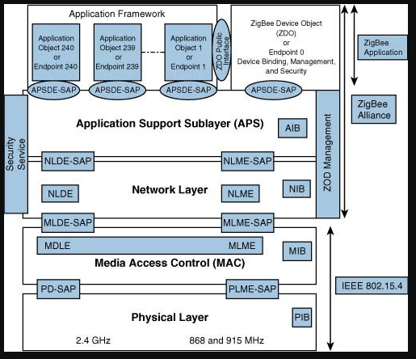
Architecture & Protocol stack used in Zigbee
Notes:
https://pdfs.semanticscholar.org/5f2a/4982a8adef2d1a6d589a155143291d440c0a.pdf

Slide 80
Architecture & Protocol stack used in Zigbee
Physical layer: The lowest two layers i.e the physical and the MAC (Medium Access Control) Layer are defined by the IEEE 802.15.4 specifications. The Physical layer is closest to the hardware and directly controls and communicates with the Zigbee radio. The physical layer translates the data packets in the over-the-air bits for transmission and vice-versa during the reception.
Medium Access Control layer (MAC layer): The layer is responsible for the interface between the physical and network layer. The MAC layer is also responsible for providing PAN ID and also network discovery through beacon requests.
Network layer: This layer acts as an interface between the MAC layer and the application layer. It is responsible for mesh networking.
Application layer: The application layer in the Zigbee stack is the highest protocol layer and it consists of the application support sublayer and Zigbee device object. It contains manufacturer-defined applications.
Notes:
https://pdfs.semanticscholar.org/5f2a/4982a8adef2d1a6d589a155143291d440c0a.pdf

Slide 81
Network Layer
This layer acts as an interface between the MAC layer and the application layer.
It is responsible for mesh networking.
Located between the MAC layer and application support sub layer
Provides the following functions:
Starting a network
Managing end devices joining or leaving a network
Route discovery
Neighbor discovery
Notes:
https://pdfs.semanticscholar.org/5f2a/4982a8adef2d1a6d589a155143291d440c0a.pdf

Slide 82
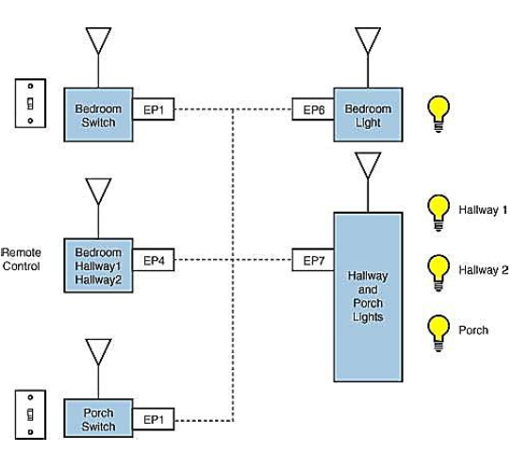
APS Layer
Application Support Sublayer (APS)
Provides services necessary for application objects (endpoints) and the ZigBee device object (ZDO)
• Some of services provided by the APS to the application objects for data transfer are Request, Confirm and Response.
1. Application Object (endpoint)
• Defines input and output to the APS
• For example, a switch that controls a light is the input from the application object, and the output is the light bulb condition
• Each node can have 240 separate application objects
Notes:
https://pdfs.semanticscholar.org/5f2a/4982a8adef2d1a6d589a155143291d440c0a.pdf

Slide 83
APS Layer
2. ZigBee Device Object (ZDO)
• Control and management of application objects
• Performs overall device management tasks:
Determines the type of device in a network
Initializes the APS, network layer, and security service provider.
Performs device and service discovery.
Initializes coordinator for establishing a network.
Security management.
Network management
3. End Node
• Each end node or end device can have multiple EPs
• Each EP contains an application profile, such as home automation
• can be used to control multiple devices or single device
4. ZigBee Addressing Mode
• ZigBee uses direct, group, and broadcast addressing for transmission of information.
Notes:
https://pdfs.semanticscholar.org/5f2a/4982a8adef2d1a6d589a155143291d440c0a.pdf

Slide 84
Daily Quiz
ZigBee / ZigBee Pro are
protocol
communication protocol
mesh communication protocol
mesh protocol
2. DigiMesh is an alternative
ZigBee
WAN
MAN
PAN

Slide 85
Daily Quiz
3. Zigbee Protocol Layers
ZigBee Device Object(ZDO)
ZigBee Cluster Library (ZCL)
Application Framework
all
4. Which of the following IEEE standards is followed by the physical and MAC layer protocols in ZigBee?
IEEE 801.15.4
IEEE 802.15.4
IEEE 803.15.4
IEEE 804.15.4

Slide 86
Daily Quiz
3. Global Sensor Network is built for _________.
Increasing cost and increasing time for development
Reducing cost and increasing time for development
Reducing cost and time for development
Increasing cost and decreasing time for development
4. WSN measures _________ physical parameter.
Sound
Temperature
Pollution
All the above

Slide 87
Recap
ZigBee is a Personal Area Network task group with low rate.
It is a technology of home networking, created for controlling and sensing the network.
Zigbee protocol stack consists of four layers viz. physical, MAC, network & security and application layer. The first two are covered in IEEE 802.15.4 WPAN standard and the later two are covered in documents published by zigbee alliance.

Slide 88
Weekly Assignment 1
What is Protocol?
Why do we need protocols?
Explain the concept of Protocols standardization.
What are the various protocol standards used in IoT?
Mention any 5 standardization bodies for IOT.
Describe the efforts of various standardization bodies.
Explain any three M2M and WSN protocols
Explain SCADA Protocols.
Explain the protocols used for SCADA applications.
What is RFID? Write down its applications.
Explain the various RFID protocols in detail.
Write short note on: Unified Data Standards
Discuss the various issues with IOT standardization in detail.

Slide 89
Weekly Assignment 2
What is MODBUS?
Write short note on Zigbee.
Draw the block diagram representing Zigbee protocol stack architecture.
Write down the applications of BAC Net Protocol.
Explain IEEE 802.11 in detail with suitable diagram.
Draw the architecture of IEEE 802.11 .
Explain the various layers of IEEE802.15.4.
Write down the advantages and disadvantages of IEEE802.15.4.
Explain the KNX protocol in detail.
Explain the APS layer of Zigbee in detail.
Write short note on:
Network layer of Zigbee
BACNet

Slide 90
Topic Links
Protocol Standardization for IoT and its efforts
https://www.youtube.com/watch?v=ikacSuYGXAI
M2M and WSN Protocols
https://www.youtube.com/watch?v=lPA9tLFMDyY
SCADA and RFID Protocol
https://www.youtube.com/watch?v=lPA9tLFMDyY
Issues with IoT Standardization and Unified Data Standards
https://www.youtube.com/watch?v=yUccPSOS83Y
IEEE802.15.4
https://www.youtube.com/watch?v=pUwYIdL_bQc

Slide 91
Topic Links
IEEE 802.11
https://www.youtube.com/watch?v=t3FVP5wuG4g
BAC Net Protocol
https://www.youtube.com/watch?v=l-oY-ePIdRs
Modbus
https://www.youtube.com/watch?v=txi2p5_OjKU
KNX
https://www.youtube.com/watch?v=K3FyVoG_X_o
Architecture and Protocol stack used in Zig bee, Network layer and APS layer.
https://www.youtube.com/watch?v=0zXTy-Uelhs

Slide 92
MCQ’s
ZigBee / ZigBee Pro are
protocol
communication protocol
mesh communication protocol
mesh protocol
2. DigiMesh is an alternative
ZigBee
WAN
MAN
PAN

Slide 93
MCQ’s
3. Zigbee Protocol Layers
ZigBee Device Object(ZDO)
ZigBee Cluster Library (ZCL)
Application Framework
all
4. Which of the following IEEE standards is followed by the physical and MAC layer protocols in ZigBee?
IEEE 801.15.4
IEEE 802.15.4
IEEE 803.15.4
IEEE 804.15.4

Slide 94
MCQ’s
5. Protocol is a set of
Formats
Procedures
Formats & Procedures
None of the mentioned
6. ebXML is the combination of___
EDL & XML
EDI & XML
HTML & XML
None of the above

Slide 95
MCQ’s
7. The control in SCADA is ______. a) Online control b) Direct control c) Supervisory control d) Automatic control
8. What is the use of the RFID Module? a) Object Identification b) To provide 3G Connectivity c) To measure temperature d) To measure Wi-Fi strength

Slide 96
Daily Quiz
9. AMQP stands for____________.
Adjustable Message Queuing Protocol
Advanced Message Queuing Protocol
Application Message Queuing Protocol
Application Mailing Queue Protocol
10. _________ are the components of MQTT Protocol.
Subscriber
Broker
Publishers
All of the above

Slide 97
Glossary Questions
(MODBUS, Wi-Fi, KNX, BACNet, IEEE 802.15.4,)
_______ is a low-cost, low-data-rate wireless access technology for devices that are operated or work on batteries.
IEEE 802.11 standard, is popularly known as_____.
_______ stands for Building Automation and Control Network.
________ protocol is widely used standard communication protocol for connecting industrial electronic devices.
_______ is a communication protocol developed for and widely used in home and building automation.
(Answer: IEEE 802.15.4, Wi-Fi, BACNet, MODBUS, KNX )

Slide 98
Old Question Paper

Slide 99
Expected Questions
Explain the various layers of IEEE802.15.4.
Explain the KNX protocol in detail.
Explain the concept of Protocols standardization.
What are the various protocol standards used in IoT?
Mention any 5 standardization bodies for IOT.
Describe the efforts of various standardization bodies.
Explain the protocols used for SCADA applications.
What is RFID? Write down its applications.
Explain the various RFID protocols in detail.
Write short note on Unified Data Standards.
Explain any three M2M and WSN protocols.
Explain SCADA Protocols.
Explain the APS layer of Zigbee in detail.
Write short note on:
Network layer of Zigbee
BACNet WSN

Slide 100
Recap Of Unit
In this Unit, we have described the Protocol Standardization for IoT and efforts of various standardization bodies.
We have also discussed M2M and WSN Protocols, SCADA and RFID Protocols
All the issues with IoT Standardization and Unified Data Standards are defined here.
In this unit, various protocols like IEEE802.15.4, IEEE 802.11, BAC Net Protocol Modbus and KNX are discussed. An overview of Zigbee technology, its architecture and Protocol stack, Network layer and APS layer are described in detail.

Slide 101
Thank YOU

